Slide 1
Southern Water Corp – Technical Presentation
Date: 5/15/2020
Presenter: Derick Lai

Slide 2
Southern Water Corp has been experiencing issues with their Surjek Desalination Plants due to increased demand from agricultural and residential usage.
!
Revenues have increased for the Calendar year but increased costs have led to a struggle to meet that demand efficiently.
Southern Water Corp has had to maximize the availability of its desalination plants to meet continual demand.
!
Abnormal High-Pressure readings for a number of pumps, indicative of system failure.
The increased demand has increased stress on the desalination systems. Failing assets will fail to bring revenue to offset the increased demand.
!
There are particular signatures around pumps that have provided abnormally high pressure readings. The pump issues stem from the pump torque.
Forecasted an increase in maintenance costs due to major outages.
Notes:
Putting this into the appendix instead? Show the methodology at the end and explain there for people that have more interest in knowing more about it.
Show instead of telling?
Put out regression read out in the appendix – Perhaps show F score, parameter estimates? – Maybe discuss more on whether some values are significant.

Slide 3
Descriptive and Inferential Analysis were undertaken to analyse the underlying issue with Surjek pump failure.
How do we identify a list of variables that provide an indication of pump failure and also develop a prototype linear equation that can be used to identify what variables are related to pump failure?
Descriptive statistics based off of Box Plot data from the Desalination Unit Data. An Outlier Removed Comparison was completed along with a Raw Time Plot of Pump Failure.
Inferential Statistics utilizing a correlation Matrix developed from Desalination Unit Data. Rolling Standard Deviations created which led to a predictive regression model to predict Pump Failure

Slide 4
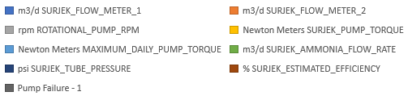
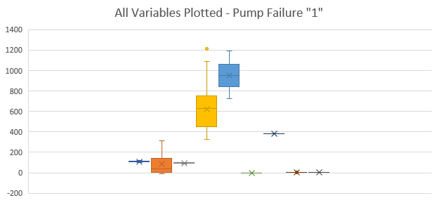
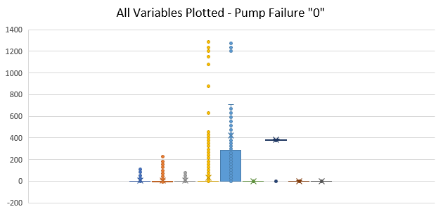
There is an increase in Surjek Pump Torque and Maximum Daily Pump Torque values when plotted for values taking account of Pump Failure occurring.
Key Insights
Increase in Maximum Daily Pump Torque when there is pump failure.
Increase in Surjek Pump Torque when there is pump failure
Increase in Surjek Flow Meter when there is pump failure
There is a significant increase in Pump Torque and Maximum Daily Pump torque values when all variables have been plotted for indicated pump failure.

Slide 5
There are several Surjek pump variables that have shown correlation to pump failure.
Key Insights
In Chart A, Variables Flow Meter 1, Flow Meter 2, Rotational Pump RPM and Pump Torque show they have some correlation in regards to Pump Failure
In Chart B, when calculating with Rolling Standard Deviations in mind, the values that stand out the most are Flow Meter 2 and Maximum Daily Pump Torque
Pump Torque displays a little less significance to pump failure in Chart B in comparison to Chart A, but this could still be an indicator of Pump Malfunction to keep in mind.
Chart A
Notes:
Still need tips and assistance with Correlation comparison. Is it just plotting the values from the correlation matrix? Or is it another standard deviation breakdown of all values for Pump Failure 0/1 (No, Yes)?

Slide 6
We have developed a regression equation based on the rolling standard deviations of the variables with an R2 of 0.625
Key Insights
* Potential long-range leading indicator of pump failure in regression equation with signature at event 1632
* Potential short-range indicator of pending pump failure starting at event 4195
* When regression equation rises above 0.3, may be sign of imminent pump failure
* Analysis of additional failure datasets required to validate and confirm
Source: Southern Water Corp Statistical Records

Slide 7
Summary Of Findings
* Among the straight variables Surjek Flow Meter 1, Rotational Pump RPM and Surjek Pump Torque correlate strongly with pump failure. Surjek Flow Meter 2 has a value to consider as well.
* Among the rolling standard deviation of variables Surjek Flow Meter 2, and Maximum Daily Pump Torque correlate strongly with pump failure. May need to consider Surjek Pump Torque in determining how significant it is to pump failure.
* A regression equation with reasonable R2 of 0.625
RECOMMENDATIONS
* Analysis of additional failure datasets
* Set warning levels for the key straight variables, rolling standard deviations and regression equation
* Pilot test warning system

